Slide 1
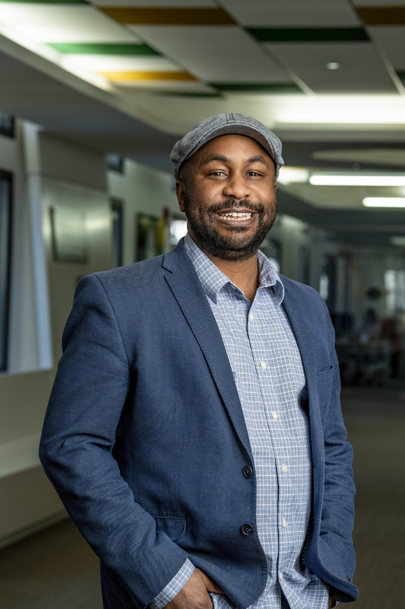



OL 3020 – Leadership Foundations | Wright State University
Influential
Leader
Dr. Emanuel O. Clayton, Ph.D.
Assistant Director – Academic Success
Student Success Center, Wright State University
Math Learning Center – Tutor Supervisor
Met: Summer 2024
Working: Spring 2025
Utsav Acharya | March 12, 2026
1 / 4

Slide 2

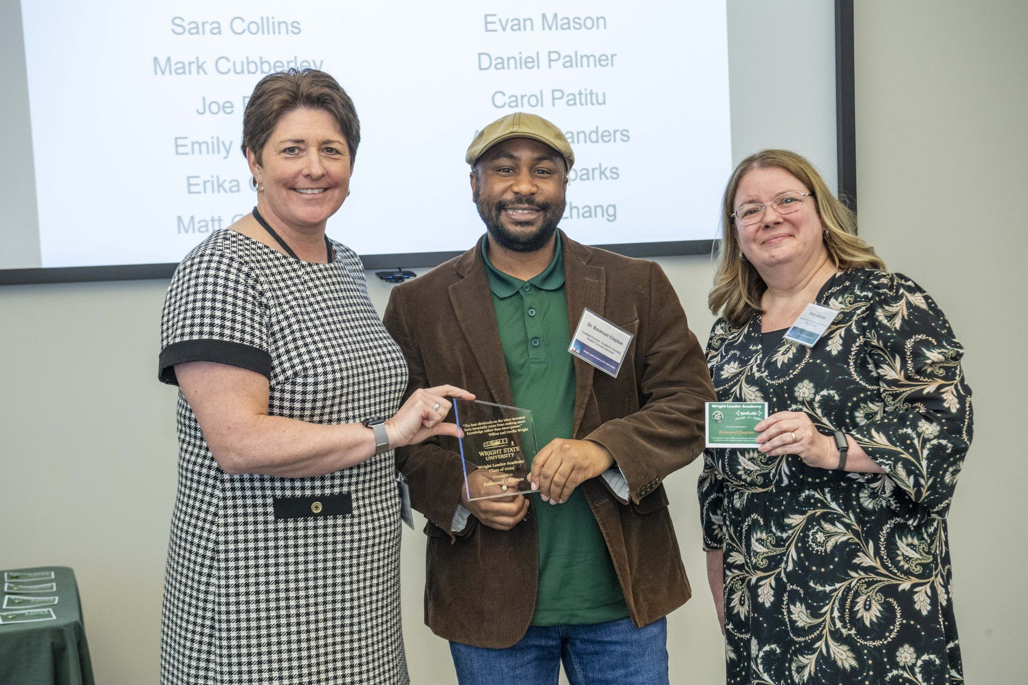

LEADERSHIP STRENGTH – CHAPTER 6
Sociability
Northouse, P. G. (2025). Ch. 6
DEFINITION
Sociability refers to a leader's ability to build positive relationships and communicate effectively with others (Northouse, 2025).
Builds Relationships
Supportive Environment
Positive Communication
Encourages tutors and students to collaborate and communicate openly.
Even when students make mistakes, he responds with encouragement.
Creates a space where students feel confident asking questions.
Dr. Clayton receiving the Wright Leader Academy Award
Utsav Acharya | OL 3020 | Wright State University
2 / 4

Slide 3

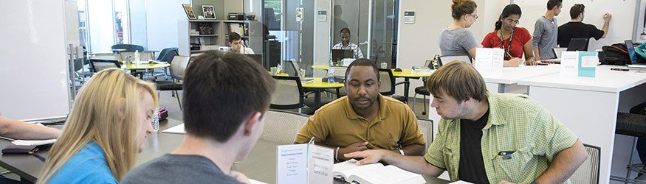
VISION IN PRACTICE – CHAPTER 7
Implements a Vision
Northouse, P. G. (2025). Ch. 7
THE VISION
Build student independence in mathematics — strengthen foundational skills so students no longer rely on others for answers.
01
02
03
Hire Right
Train & Prepare
Guide to Independence
Selects tutors with knowledge and patience to guide struggling students.
Trains tutors for online and in-person sessions, building professional skills.
Tutors walk students through thinking, not just giving answers.
Tutoring session at the Math Learning Center, Wright State University
Utsav Acharya | OL 3020 | Wright State University
3 / 4

Slide 4
References
Northouse, P. G. (2025). Introduction to leadership: Concepts and practice (6th ed.). Sage Publications.
Textbook
Clayton, E. O. (2026). Wright State University profile. https://people.wright.edu/emanuel.clayton
Leader Profile
Utsav Acharya | OL 3020 – Leadership Foundations | Wright State University | March 12, 2026

